Slide 1
Table of Contents
Loops
Execute Blocks of Code Multiple Times
What is a Loop?
Loops in JavaScript
while loops
do … while loops
for loops
Special loop operators
break, continue
Nested loops

Slide 2
What Is Loop?
A loop is a control statement that allows repeating execution of a block of statements
May execute a code block fixed number of times
May execute a code block while given condition holds
May execute a code block for each member of a collection
Loops that never end are called an infinite loops

Slide 3
Using while(…) Loop
Repeating a Statement While Given Condition Holds

Slide 4
How To Use While Loop?
The simplest and most frequently used loop
The repeat condition
Also called loop condition
Is not necessary true or false
Is evaluated to true or false
5, "non-empty", etc.. are evaluated as true
0, "", null are evaluated as false
while (condition) {
statements;
}

Slide 5
While Loop – How It Works?
condition
false
true
statement

Slide 6
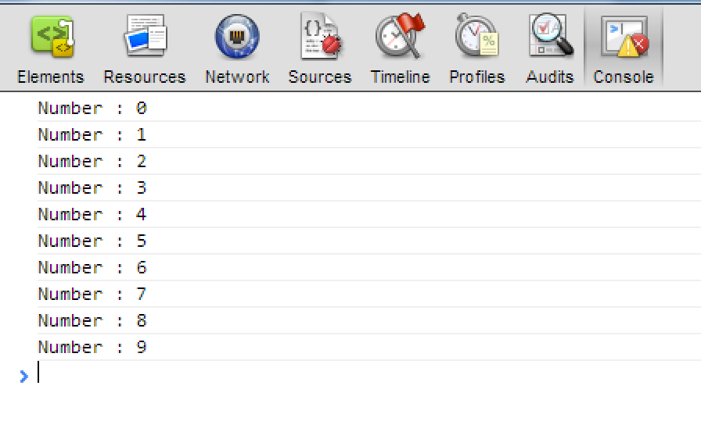
While Loop – Example
var counter = 0;
while (counter < 10) {
console.log('Number : ' + counter);
counter++;
}

Slide 7
Sum 1..N – Example
while(…) Examples
Calculate and print the sum of the first N natural numbers
var nStr = read('input-tb');
var n = parseInt(nStr);
var number = 1;
var sum = 1;
var result = 'The sum 1';
while (number < n) {
number++;
sum += number ;
result += '+' + number;
}
result += ' = ' + sum;
print('console-out',result);

Slide 8
Prime Number – Example
Checking whether a number is prime or not
var numberStr = read('input-tb');
var number = parseInt(numberStr);
var divider = 2;
var maxDivider = Math.sqrt(number);
var prime = true;
while (prime && (divider <= maxDivider)) {
if (number % divider == 0) {
prime = false;
}
divider++;
}
print('output-tb',prime);
While Loop – Live Demo

Slide 9
Using break Operator
break operator exits the inner-most loop
var numberStr = read('input-tb');
var n = parseInt(numberStr);
var fact = 1;
var factStr = 'n! = ';
while (true) {
if (n == 1)
break;
factStr += n + '*'
fact *= n;
n--;
}
factStr += '1 = ' + fact;
print('output-tb',factStr);
Calculating Factorial – Live Demo

Slide 10
Using do { … } while (…) Loop
Another loop structure is:
The block of statements is repeated
While the boolean loop condition holds
The loop is executed at least once
do {
statements;
} while (condition);

Slide 11
Do-While Statement
statement
true
condition
false

Slide 12
Factorial – Example
do { … } while (…) Examplesx
Calculating N factorial
var fact = 1;
var factStr = 'n! = ';
do {
fact *= n;
factStr += n + '*'
n--;
} while (n);
factStr += ' = ' + fact;
print('output-tb',factStr);

Slide 13
Product[N..M] – Example
Calculating the product of all numbers in the interval [n..m]:
var number = n;
var product = 1;
var productStr = '';
do {
product *= number;
productStr += number;
if (number != m) {
productStr += '*';
}
number++;
} while (number <= m);
productStr += ' = ' + product;
print('output-tb', productStr);
do-while Loop – Live Demo

Slide 14
For Loops
The typical for loop syntax is:
Consists of
Initialization statement
Test expression that is evaluated to boolean
Update statement
Loop body block
for (initialization; test; update) { statements; }

Slide 15
The Initialization Expression
for (var number = 0; ...; ...) { // Can use number here } // Cannot use number here
Executed once, just before the loop is entered
Like it is out of the loop, before it
Usually used to declare a counter variable

Slide 16
The Test Expression
for (var number = 0; number < 10; ...) { // Can use number here } // Cannot use number here
Evaluated before each iteration of the loop
If evaluated true, the loop body is executed
If evaluated false, the loop body is skipped
Used as a loop condition

Slide 17
The Update Expression
for (var number = 0; number < 10; number++) { // Can use number here } // Cannot use number here
Executed at each iteration after the body of the loop is finished
Usually used to update the counter

Slide 18
Simple for Loop – Example
A simple for-loop to print the numbers 0…9:
for (var number = 0; number < 10; number++) {
console.log(number + ' ');
}
A simple for-loop to calculate n!:
var factorial = 1;
for (var i = 1; i <= n; i++) {
factorial *= i;
}

Slide 19
Complex for Loop – Example
Complex for-loops could have several counter variables:
for (var i=1, sum=1; i<=128; i=i*2, sum+=i) {
console.log('i=' + i + ', sum=' +sum);
}
Result:
i=1, sum=1
i=2, sum=3
i=4, sum=7
i=8, sum=15
...

Slide 20
N^M – Example
Calculating n to power m (denoted as n^m):
var result = 1;
for (var i=0; i<m; i++) {
result *= n;
}
console.log(result);
Calculating N^M - Live Demo

Slide 21
What Is Nested Loop?
Nested Loops
Using Loops Inside a Loop
A composition of loops is called a nested loop
A loop inside another loop
Example:
for (initialization; test; update) {
for (initialization; test; update) {
statements;
}
…
}

Slide 22
Triangle – Example
Nested Loops - Examples
Print the following triangle:
1
1 2
…
1 2 3 ... n
var resultStr = '';
for(var row = 1; row <= n; row++) {
for(var column = 1; column <= row; column++) {
resultStr += column + ' ';
}
resultStr += '\n';
}
console.log(resultStr);
Triangle – Live Demo

Slide 23
Primes[N, M] – Example
Print all prime numbers in the interval [n, m]:
var result='';
for (var number = n; number <= m; number++) {
var isPrime = true;
var divider = 2;
var maxDivider = Math.sqrt(number);
while (divider <= maxDivider) {
if (number % divider == 0){
isPrime = false;
break;
}
divider++;
}
if (isPrime) {
result += number + ' ';
}
}
Primes in Range [n, m] – Live Demo

Slide 24
Nested Loops – Examples
Print all four digit numbers in format ABCD such that A+B = C+D (known as happy numbers)
Can you improve this algorithm to use 3 loops only?
for (var a =1 ; a <= 9; a++)
for (var b = 0; b <= 9; b++)
for (var c = 0; c <= 9; c++)
for (var d = 0; d <= 9; d++)
if (a + b == c + d)
console.log('{0}{1}{2}{3}',
a, b, c, d);
}

Slide 25
Nested Loops – Examples
Print all combinations from TOTO 6/49
Warning: execution of this code could take too long time.
var i1, i2, i3, i4, i5, i6;
for (i1 = 1; i1 <= 44; i1++)
for (i2 = i1 + 1; i2 <= 45; i2++)
for (i3 = i2 + 1; i3 <= 46; i3++)
for (i4 = i3 + 1; i4 <= 47; i4++)
for (i5 = i4 + 1; i5 <= 48; i5++)
for (i6 = i5 + 1; i6 <= 49; i6++)
console.log('{0} {1} {2} {3} {4} {5}',
i1, i2, i3, i4, i5, i6);

Slide 26
for-in Loop
Iterating over the properties of object
for-in loop iterates over the properties of an object
When the object is array, nodeList or liveNodeList for-in iterates over their elements
When the object is not an array, for-in iterates over its properties

Slide 27
for-in Loop (2)
Iterating over the elements of an array
Iterating over the properties of document
var arr = [1, 2, 3, 4, 5, 6];
for(var index in arr) { console.log(arr[i]) }
//1, 2, 3, 4, 5, 6
for(var prop in document){ console.log(document[prop]) }
//http://localhost:64765/xxx%20for-in-loop.html
//function querySelector() { [native code] }
//function querySelectorAll() { [native code] }
//function evaluate() { [native code] }
for-in Loop – Live Demo

